Slide 1
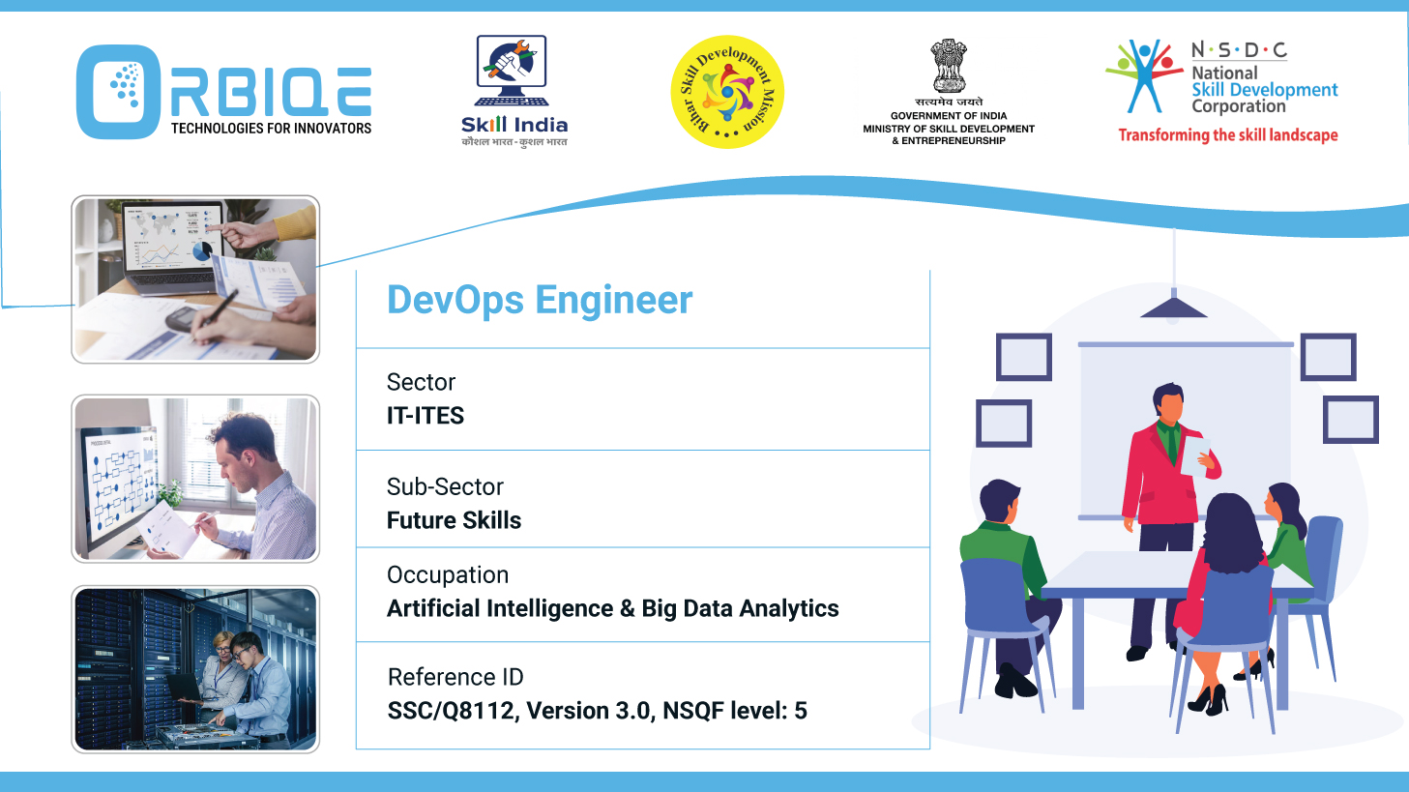
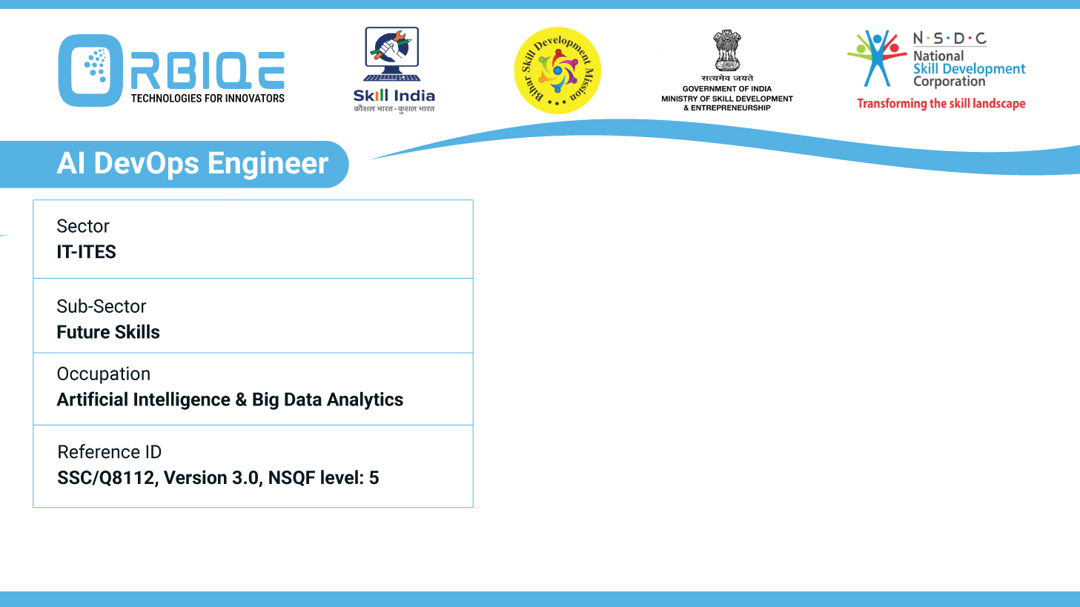
Name- Krishna Kant Dubey

Slide 2

CICD Lifecycle

Slide 3
Agenda
Continuous Integration (CI)
Integrating code changes into a shared repository
Continuous Delivery (CD)
Deployment process to staging environments
Continuous Deployment
Automatically deploying changes to production environments

Slide 4
Continuous Integration (CI)

Slide 5
Continuous Delivery (CD)

Slide 6
Continuous Deployment

Slide 7
Thank You

